Slide 1
ASTRO 2020 Highlights
Richard Li MD

Slide 2
I have no disclosures

Slide 3
Outline
CCTG SC.24/TROG trial showing superior pain control for SBRT 24 Gy in 2 fractions over conventional fractionation
MDACC trial showing equivalent OS/better neurocognitive outcome for SRS vs WBRT in 4-15 brain mets
FLAME trial for focal dose escalation in prostate
EMPIRE trial showing better BPFS with use of axumin scan post prostatectomy
CRTOG1601 Chinese RCT showing OS benefit for PET-based boost to 66 Gy in NSCLC

Slide 4
CCTG SC.24/TROG
Randomized phase II/III trial of 229 patients
Randomized to 24 Gy/2 fractions (SBRT) vs 20 Gy in 5 fractions CRT
Primary endpoint: 3-month complete response to pain
Outcome: Significantly improved pain response with SBRT (16 vs 33%), p<0.001
Toxicity: no difference in grade 2+ AE (12 vs 11%), compression fx (17 vs 11%),
QOL: No difference other than financial perception favored SBRT

Slide 5
CCTG SC.24/TROG
Eligibility criteria:
Solid tumor
≤3 consecutive spinal segments
Symptomatic pain
Not unstable, no spinal cord compression
No chemotherapy within 1 week of RT
Stratification factors
Extra-osseous extension
Radioresistant vs radiosensitive

Slide 6
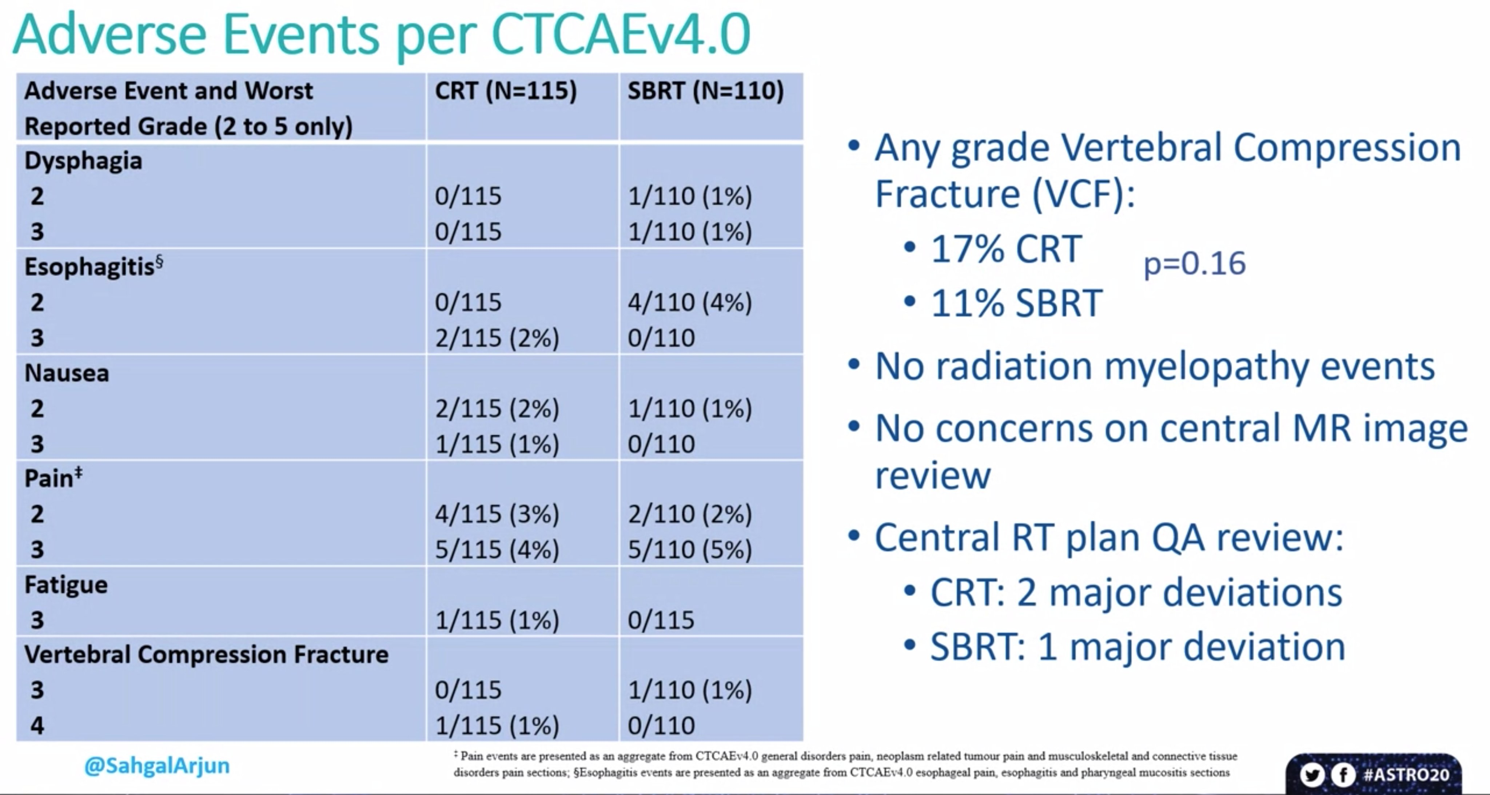

Slide 7
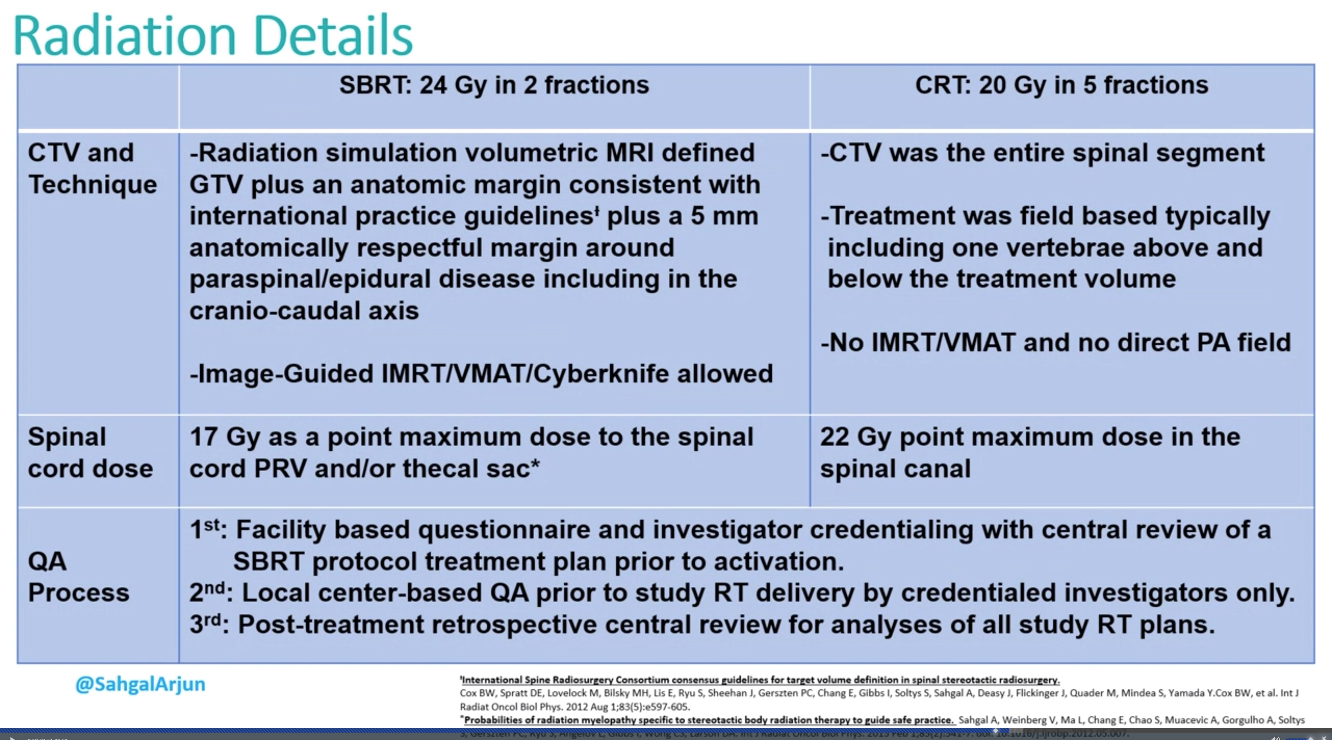

Slide 8
FLAME trial
571 patients with int-/high-risk prostate cancer from 2009-2015
Randomized to: EBRT 77 Gy over 35 fractions vs EBRT with focal boost up to 95 Gy
Primary endpoint: 5-year biochemical DFS
Outcome: 93% 5-year DFS in the focal boost arm, 86% in the standard arm
No difference in toxicities

Slide 9
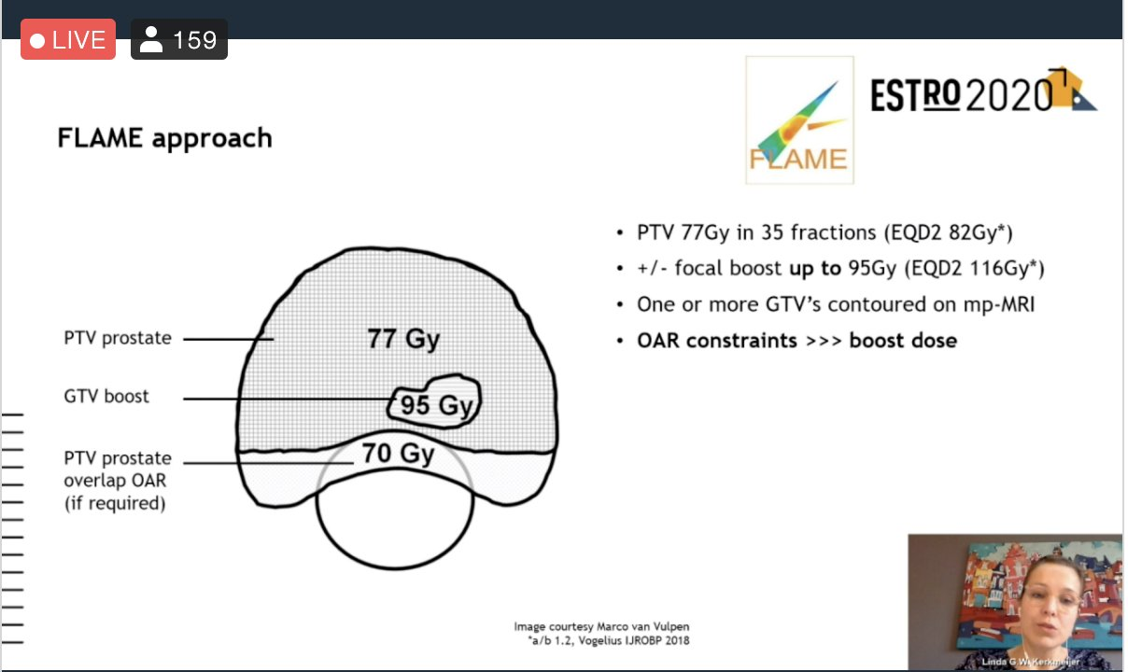

Slide 10
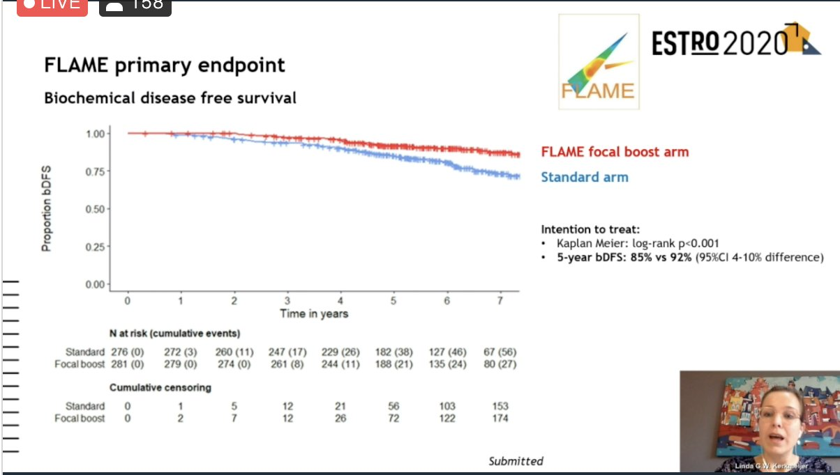

Slide 11
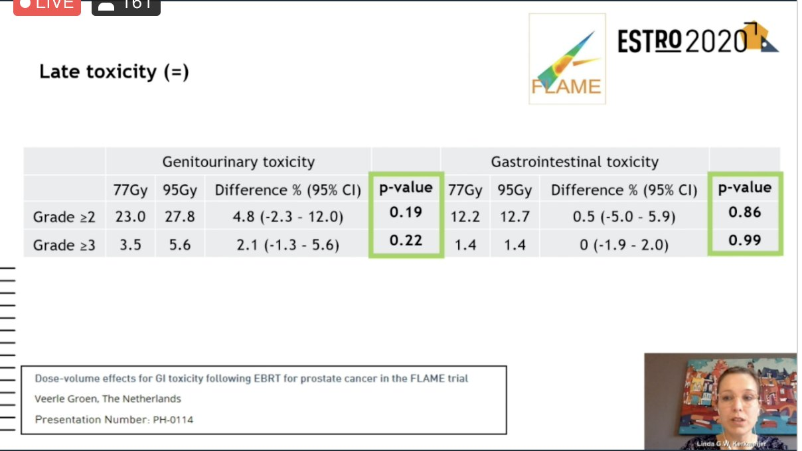

Slide 12
MDACC Brain metastases trial
100 patients, single institution randomized trial
Randomized to SRS (15-24 Gy per RTOG 9005) vs 30/10 WBRT
Primary endpoint: neurocognitive function
Outcome: improved neurocog, no difference in OS with SRS

Slide 13
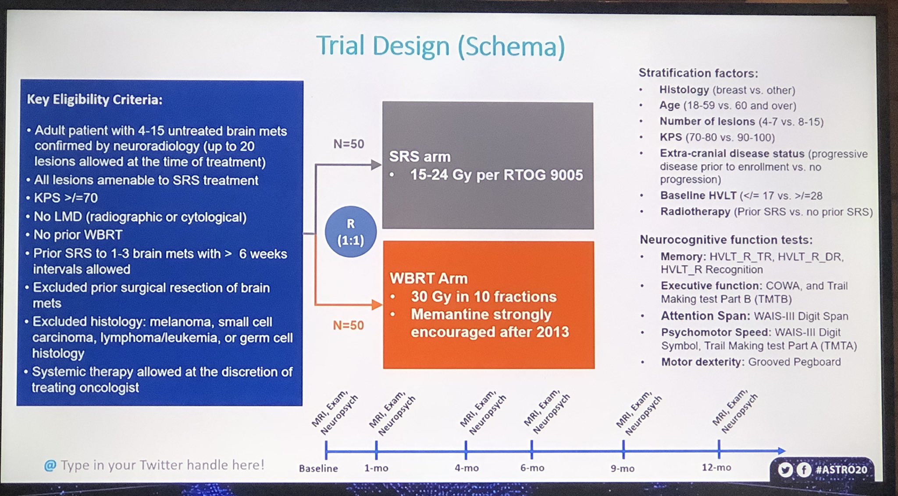

Slide 14
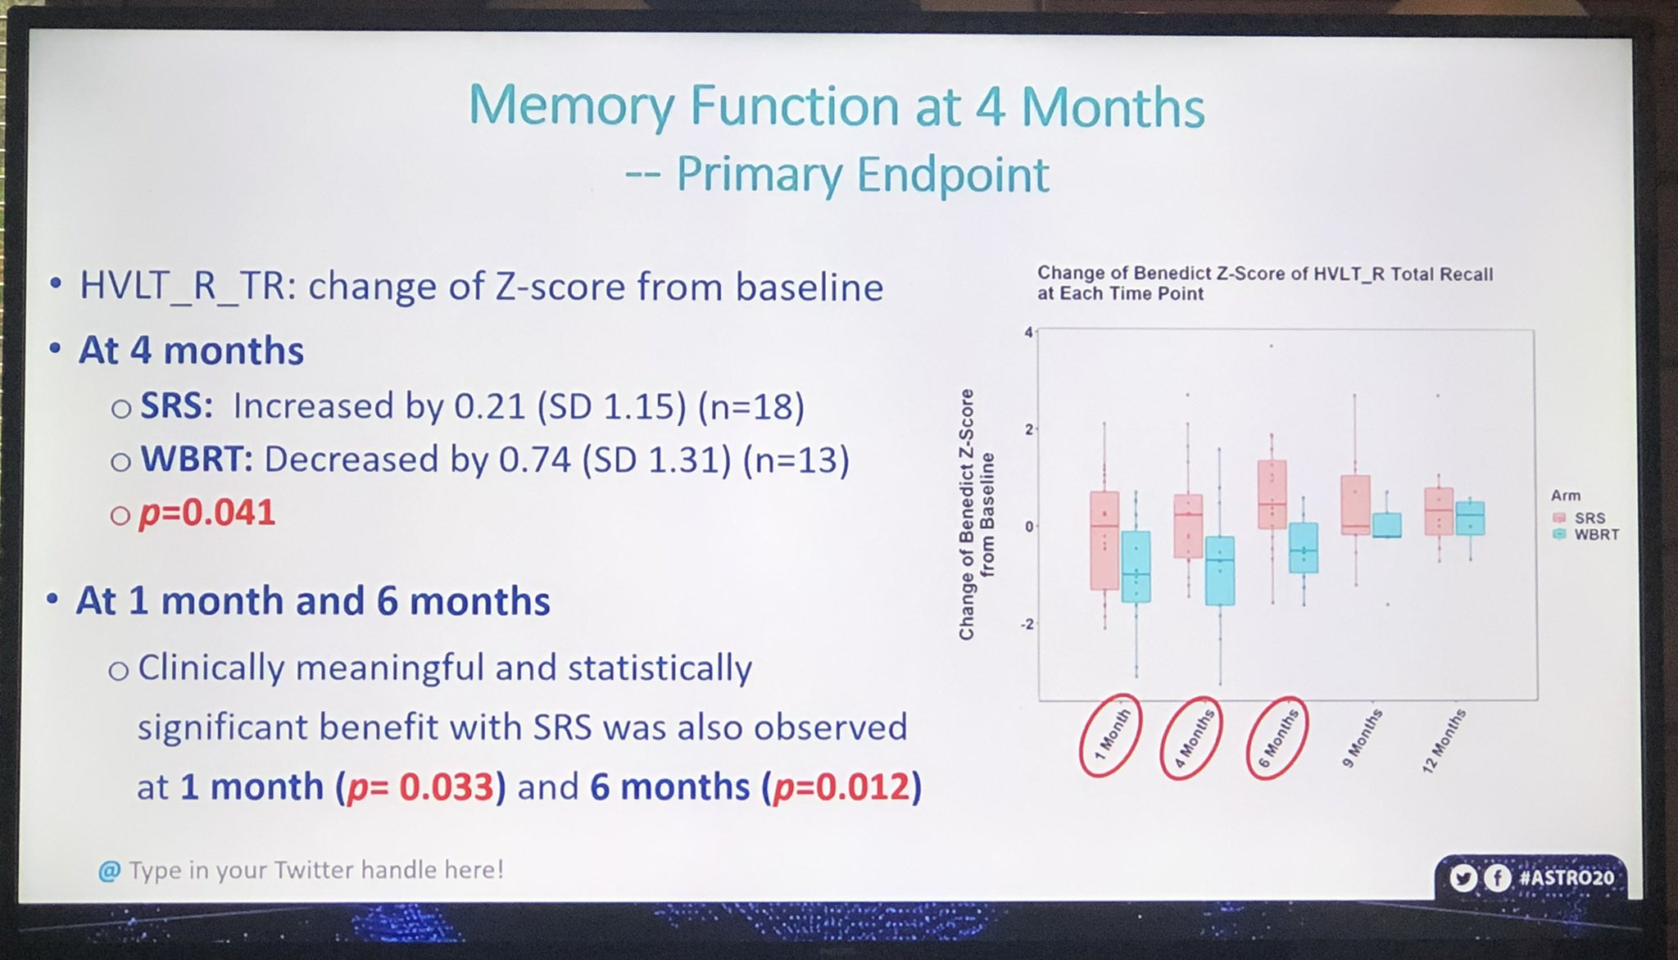

Slide 15
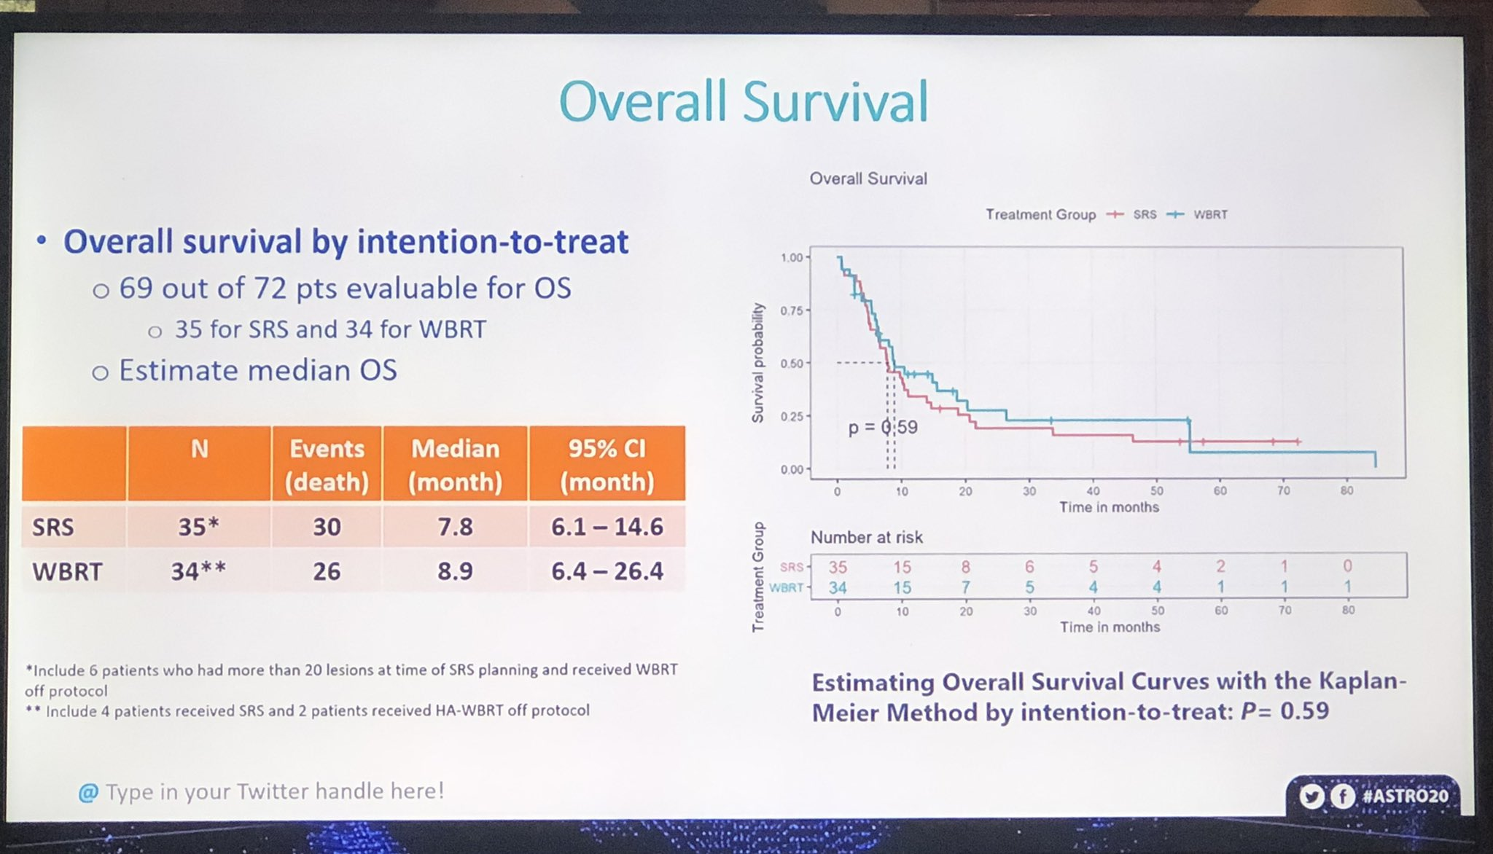

Slide 16
EMPIRE trial
Phase II/III randomized trial of Fluciclovine/Axumin PET-CT scan, 165 patients
Randomized to conventional imaging (bone scans/CT/MRI) alone +/- fluciclovine PET/CT scan
Outcome: Improved DFS in patients with the more advanced imaging (p=0.003), 51% vs 75.5%
EMPIRE-2 compares PSMA to axumin

Slide 17
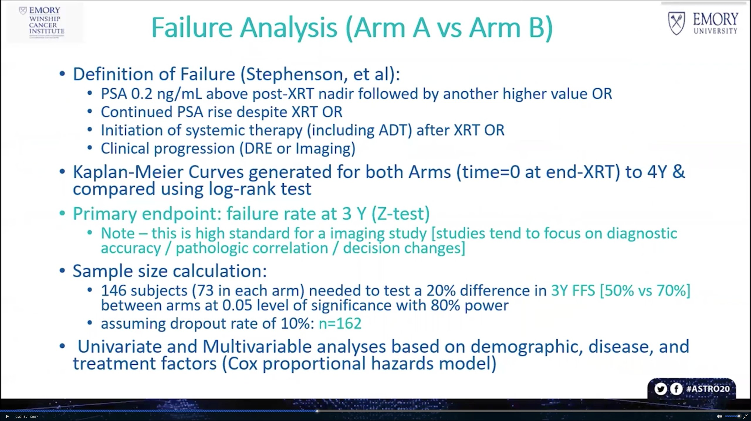

Slide 18
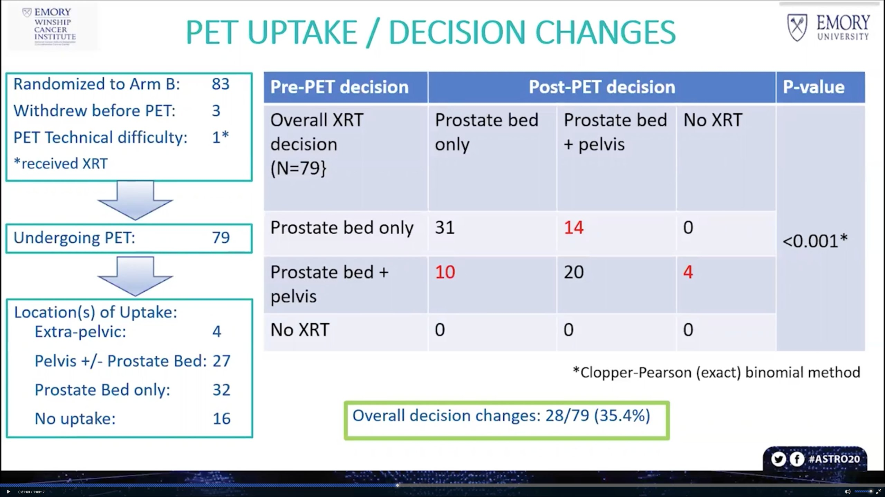

Slide 19
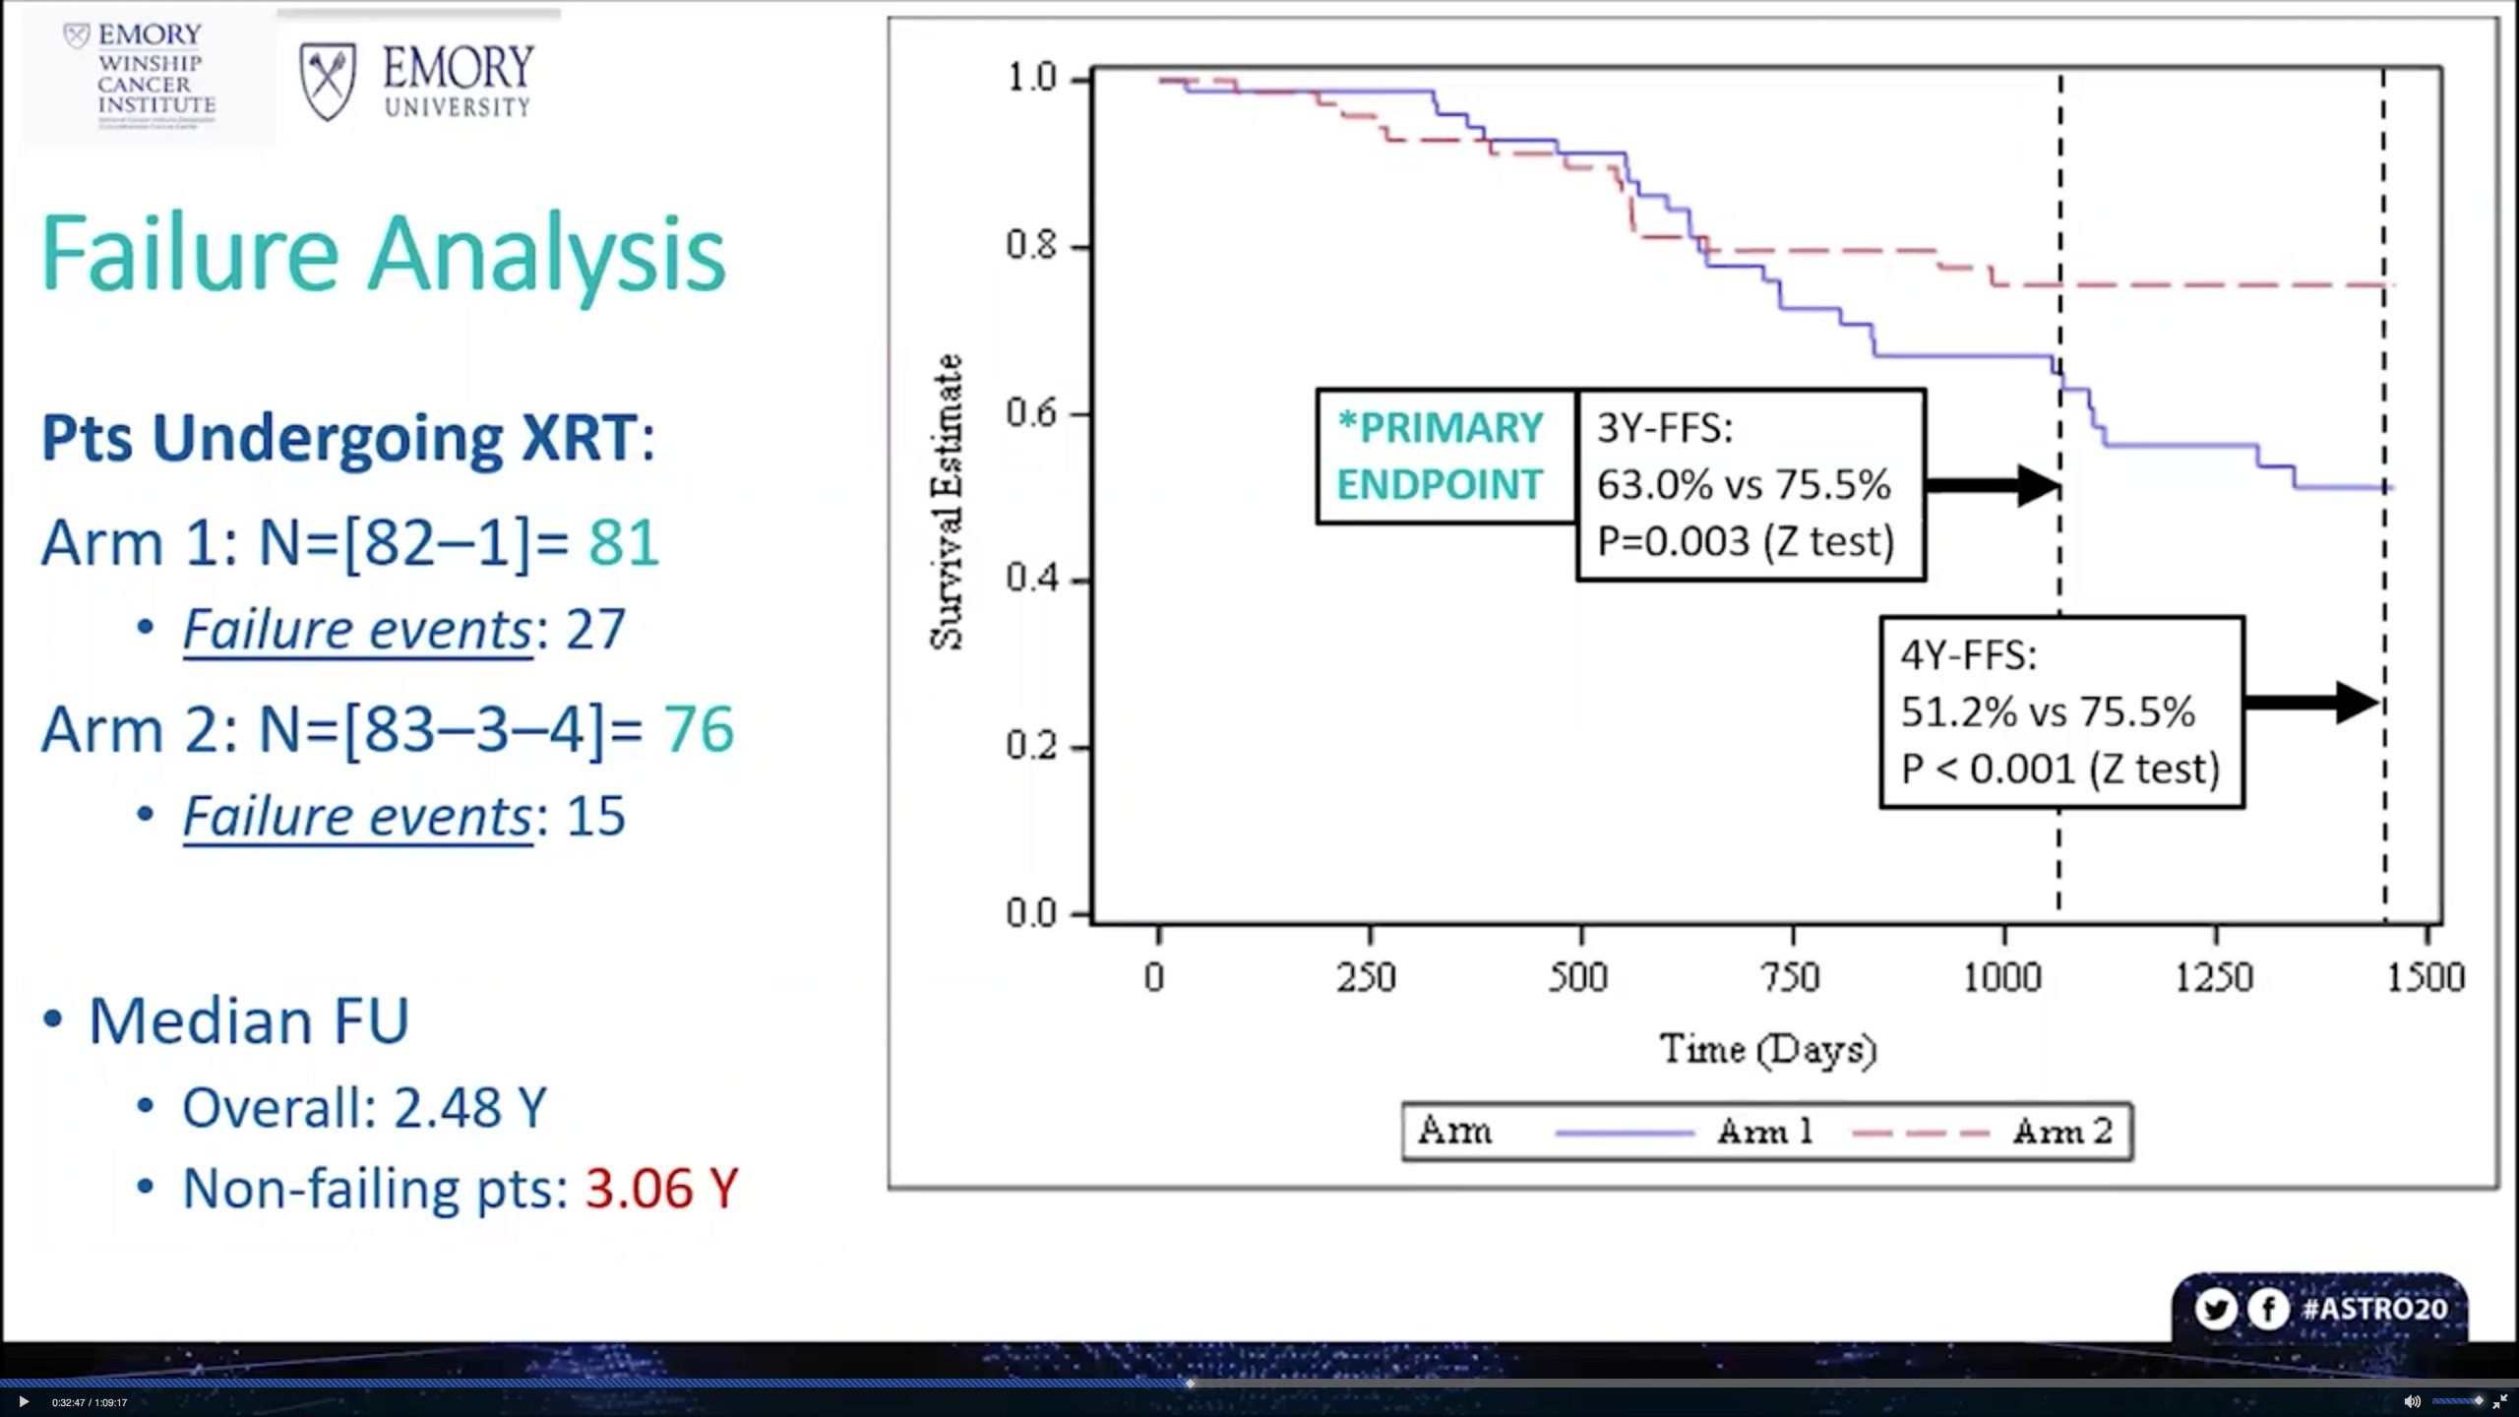

Slide 20
CRTOG1601
Phase 3 randomized Chinese trial of 243 patients
Unresectable stage III NSCLC randomized to standard dose (60 Gy/30 fx) vs adaptive dose escalation (66+ Gy / 30 fractions)
Outcome: Significantly better OS in the individualized group (median 44.6 vs 28 months) and PFS (15.1 vs 11.6 months)
No difference in toxicity

Slide 21
CRTOG1601
After 18-20 fractions, repeat CT simulation and PET/CT in original position was performed
Dose escalation from 22-32 Gy in 10 fractions to the adaptive target contoured based on PET
Concurrent therapy: cisplatin/pemetrexed for adeno, cisplatin/docetaxel for squamous

Slide 22
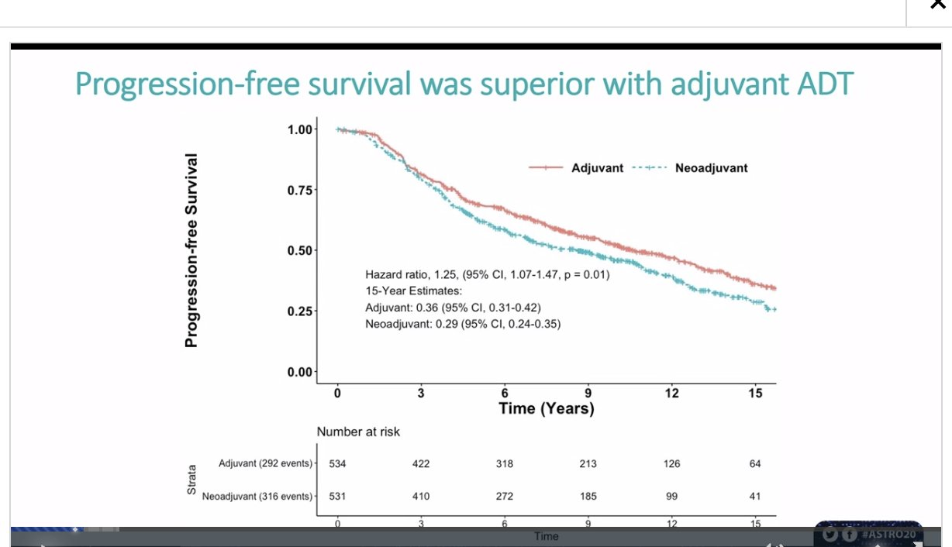
Spratt meta-analysis of Neoadjuvant vs Adjuvant

Slide 23
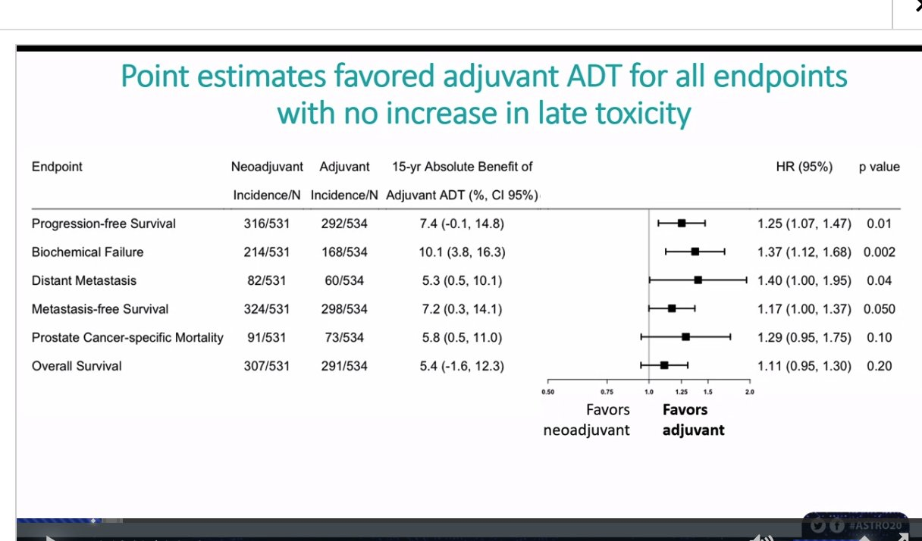

Slide 24
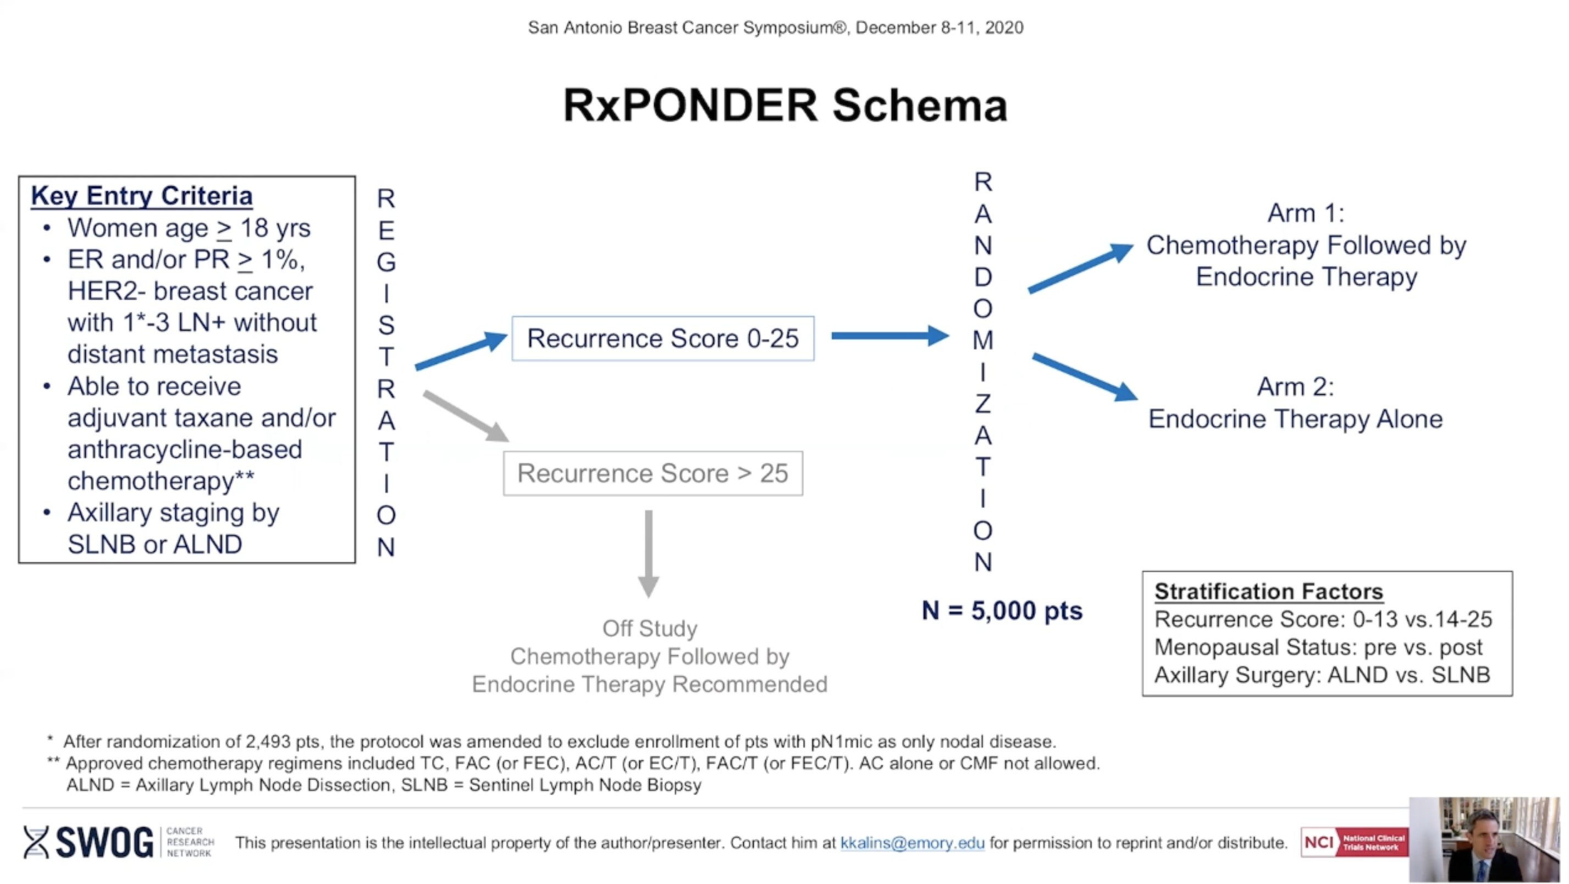
Rxponder

Slide 25
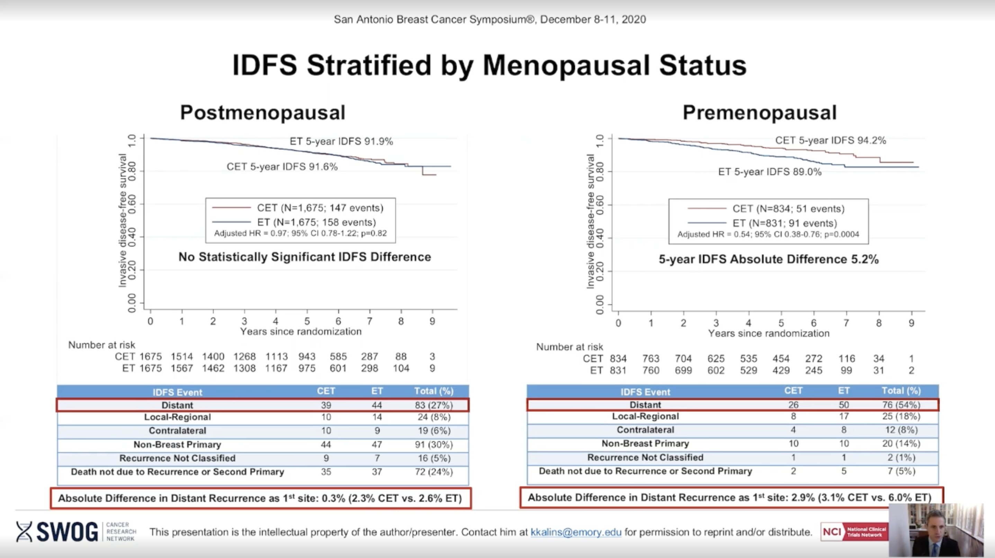

Slide 26
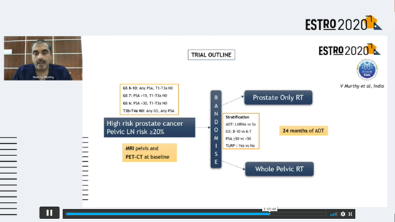
Tata Memorial Pelvic RT

Slide 27
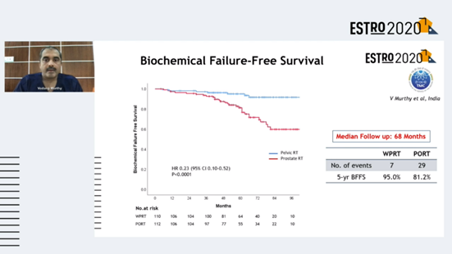

Slide 28
